Slide 1
Unit II Data Structure

Slide 2
Linked List
Operations on Linked List:
Traversing the Nodes
Searching for a Node
Prepending Nodes
Removing Nodes

Slide 3
Operations on Linked List:
Traversing the Nodes
Traversing a linked list requires the initialization and adjustment of temporary external reference variable.

Slide 4
 | 1
 |  |  | 2
 |  |  |  |  | 3
Head
curNode
a. After initializing the temporary external reference

Slide 5
 | 1
 |  |  | 2
 |  |  |  |  | 3
Head
curNode
b. Advancing the external reference after printing 1

Slide 6
 | 1
 |  |  | 2
 |  |  |  |  | 3
Head
curNode
c. Advancing the external reference after printing 2

Slide 7
 | 1
 |  |  | 2
 |  |  |  |  | 3
Head
curNode
d. The external reference is set to NULL after printing 3

Slide 8
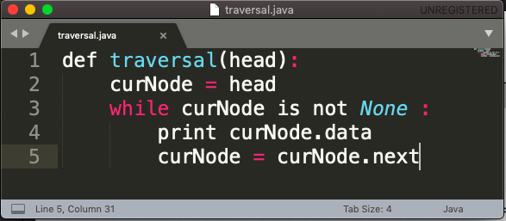
Algorithms ?
Time Complexity???
O(n)

Slide 9
Operations on Linked List:
Searching for the Nodes
A Linear search operation can be performed on a linked list. It is very similar to the traversal demonstrated earlier. The only difference is that the loop can be terminated early if we find the target value within the list.

Slide 10
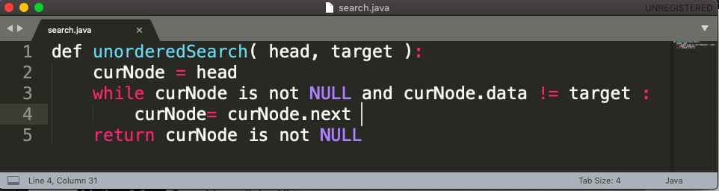
Algorithms ?
Time Complexity???
O(n)

Slide 11
Operations on Linked List:
3. Perpending Nodes
When working with an unordered list, new values can be inserted at any point within the list.
Inserting an element at the head of the singly Linked List
Inserting an element at the tail of the singly Linked List

Slide 12
Operations on Linked List:
3. Perpending Nodes
Inserting an element at the head of the singly Linked List

Slide 13
Head
 | 1
 |  |  | 2
 |  |  |  |  | 3
newest
2
96
1
i. Link modifications required to prepend the node

Slide 14
Head
 | 1
 |  |  | 2
 |  |  |  |  | 3
96
ii. Result after prepending 96.

Slide 15
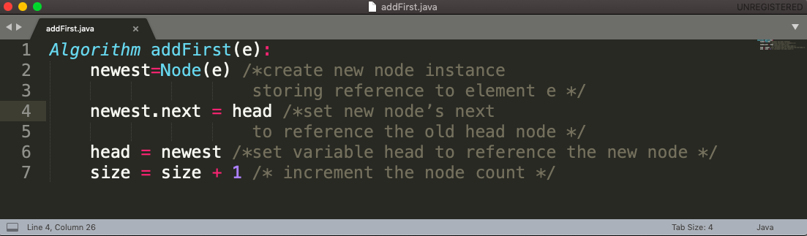
Algorithms ?
Inserting an element at the head of the singly Linked List
Time Complexity???
O(1)

Slide 16
Operations on Linked List:
3. Perpending Nodes
b. Inserting an element at the tail of the singly Linked List

Slide 17
 | 1
 |  |  | 2
 |  |  |  |  | 3
Tail
newest
96
NULL
NULL
i. After creation of new node

Slide 18
 | 1
 |  |  | 2
 |  |  |  |  | 3
Tail
newest
96
NULL
ii. After reassignment of tail reference

Slide 19
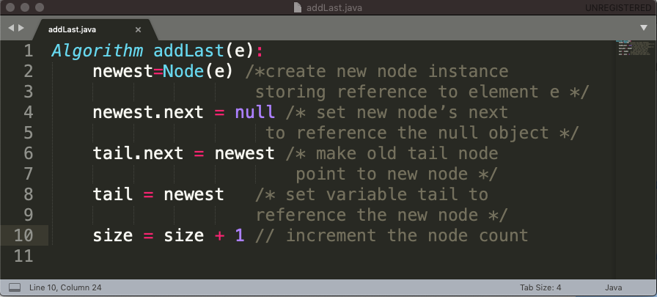
Algorithms ?
b. Inserting an element at the tail of the singly Linked List
Time Complexity???
O(1)

Slide 20
Operations on Linked List:
3. Removing Nodes
An item can be removed from a linked list by removing or unlinking the node containing that item.
Removing an element from the head of a singly linked list is essentially the reverse operation of inserting a new element at the head.

Slide 21
Head
 | 1
 |  |  | 2
 |  |  |  |  | 3
96
i. Before the removal.

Slide 22
Head
 | 1
 |  |  | 2
 |  |  |  |  | 3
96
ii. After linking out the old head

Slide 23
Head
 | 1
 |  |  | 2
 |  |  |  |  | 3
iii. Final COnfiguration

Slide 24
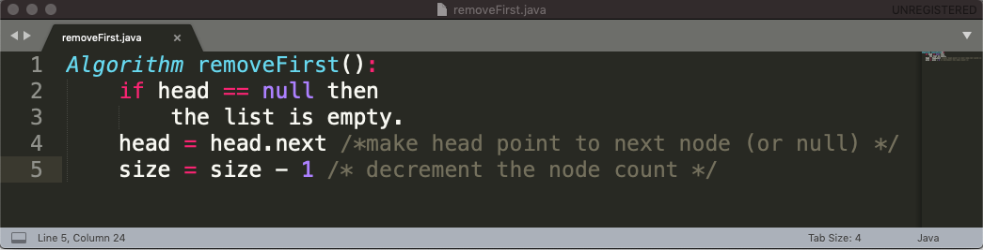
Algorithms ?
Time Complexity???
O(1)

Slide 25
Operations on Linked List:
3. Removing Nodes
CAN WE REMOVE A NODE FROM THE TAIL OF THE LINKED LIST???

Slide 26
Implementing a Singly Linked List Class
size(): Returns the number of elements in the list.
isEmpty(): Returns true if the list is empty, and false otherwise.
first(): Returns(but does not remove) the first element in the list.
last(): Returns (but does not remove) the last element in the list.
addFirst(e): Adds a new element to the front of the list.
addLast(e): Adds a new element to the end of the list.
removeFirst(): Removes and returns the first element of the list.
Note: If first(), last(), or removeFirst() are called on a list that is empty, we will simply return a null reference and leave the list unchanged.

